Slide 1
THE ROMANIAN GAS TRANSMISSION SYSTEM OPERATOR
PRELIMINARY UNAUDITED FINANCIAL STATEMENTS
FOR 2013
PREPARED IN ACCORDANCE WITH THE IFRS - EU

Slide 2
Summary
3. Main earnings drivers
4. Capital expenditures and investments
2. Balance sheet as of 31.12.2013
1. Income statement as of 31.12.2013
6. Shareholders
8. Management
7. Market indicators
5. Economic and financial indicators as of 31.12.2013

Slide 3
1. Income statement as of 31.12.2013
COMPREHENSIVE INCOME -RON | 31.12.2013 | 31.12.2012 | CHANGES
 |  |  | absolute | relative
Revenues from domestic gas transmission activity | 1,210,480,230 | 1,052,112,211 | 158,368,019 | 15.05%
Revenues from international gas transmission activity | 268,537,107 | 275,875,022 | -7,337,915 | -2.66%
Other revenues | 37,440,227 | 37,382,118 | 58,109 | 0.16%
Revenues from operations | 1,516,457,564 | 1,365,369,351 | 151,088,213 | 11.07%
Depreciation | (180,894,433) | (164,539,650) | (16,354,783) | 9.94%
Wages, salaries and other employee-related expenses | (292,079,720) | (284,268,737) | (7,810,983) | 2.75%
Technological consumption, materials and consumables used | (121,422,078) | (145,183,283) | 23,761,205 | -16.37%
Royalty expenses | (147,901,734) | (132,798,723) | (15,103,011) | 11.37%
Maintenance and transportation | (71,644,490) | (111,307,785) | 39,663,295 | -35.63%
Other employee benefits | (54,912,669) | (51,479,308) | (3,433,361) | 6.67%
Taxes and other amounts payable to the State | (54,342,445) | (15,531,417) | (38,811,028) | 249.89%
Expenses with provision for employee benefits | (1,691,969) | (30,767,646) | 29,075,677 | -94.50%
Expenses with provision for risks and expenses | (8,609,654) | (5,100,602) | (3,509,052) | 68.80%
Other operating expenses | (54,318,441) | (59,471,143) | 5,152,702 | -8.66%
Total operating expenses | (987,817,633) | (1,000,448,294) | 12,630,661 | -1.26%
Operating profit | 528,639,931 | 364,921,057 | 163,718,874 | 44.86%
Financial revenues | 40,777,695 | 54,789,614 | (14,011,919) | -25.57%
Financial costs | (141,597,037) | (26,795,040) | (114,801,997) | 428.44%
Financial income, net | (100,819,342) | 27,994,574 | (128,813,916) | -460.14%
Profit before tax | 427,820,589 | 392,915,631 | 34,904,958 | 8.88%
Income tax expense | (90,954,790) | (63,610,388) | (27,344,402) | 42.99%
Period related net profit and total comprehensive income | 336,865,799 | 329,305,243 | 7,560,556 | 2.30%
Basic and diluted result per share ( expressed in RON/share) | 28.61 | 27.97 | 0.64 | 2.30%

Slide 4
2. Balance sheet as of 31.12.2013
FINACIAL POSITION | 31 .12.2013 | 31.12.2012 | CHANGES
ASSETS |  |  | absolute | relative
Non-current assets
Intangible assets | 2,532,641,542 | 2,495,791,792 | 36,849,750 | 1.48%
Tangible assets | 697,217,545 | 742,427,911 | -45,210,366 | -6.09%
Financial assets available for sale | 5,953,263 | 105,356,906 | -99,403,643 | -94.35%
 | 3,235,812,350 | 3,343,576,609 | -107,764,259 | -3.22%
Current assets
Inventories | 33,526,925 | 35,827,551 | -2,300,626 | -6.42%
Trade and other receivables | 401,261,834 | 347,781,745 | 53,480,089 | 15.38%
Cash and cash equivalents | 267,261,147 | 178,637,942 | 88,623,205 | 49.61%
 | 702,049,906 | 562,247,238 | 139,802,668 | 24.86%
TOTAL ASSETS | 3,937,862,256 | 3,905,823,847 | 32,038,409 | 0.82%
EQUITY AND LIABILITIES
Equity
Share capital | 117,738,440 | 117,738,440 | 0
Capital adjustments as a result of hyperinflation | 441,418,396 | 441,418,396 | 0
Share premium | 247,478,865 | 247,478,865 | 0
Other reserves | 1,265,796,861 | 1,265,796,861 | 0
Retained earnings | 1,001,344,420 | 915,143,887 | 86,200,533 | 9.42%
 | 3,073,776,982 | 2,987,576,449 | 86,200,533 | 2.89%
Long term liabilities
Long term loans | 24,000,000 | 48,000,000 | -24,000,000 | -50.00%
Provision for employee benefits | 64,005,778 | 62,313,809 | 1,691,969 | 2.72%
Deferred income | 370,180,329 | 362,261,072 | 7,919,257 | 2.19%
Deferred tax liability | 85,283,060 | 90,372,543 | -5,089,483 | -5.63%
 | 543,469,168 | 562,947,424 | -19,478,256 | -3.46%
Current liabilities
Trade and other payables | 262,081,029 | 255,368,831 | 6,712,198 | 2.63%
Provision for risks and charges | 27,200,907 | 18,591,252 | 8,609,655 | 46.31%
Current income tax liabilities | 7,334,168 | 57,339,891 | -50,005,723 | -87.21%
Short term loans | 24,000,000 | 24,000,000 | 0
 | 320,616,106 | 355,299,974 | -34,683,868 | -9.76%
Total liabilities | 864,085,274 | 918,247,398 | -54,162,124 | -5.90%
Total equity and liabilities | 3,937,862,256 | 3,905,823,847 | 32,038,409 | 0.82%

Slide 5
3. Main earnings’ drivers (1)
Revenue growth in 2013 compared to 2012

Slide 6
3. Main earnings’ drivers (2)
Aggressive savings policy lowers operating expenses in 2013 (thousand RON)
Operating expenses 2013 compared to 2012 (thousand RON)

Slide 7
3. Main earnings’ drivers (3)
Tariff increase did not offset the influence of Nabucco provision

Slide 8
3. Main earnings’ drivers (4)
The influence of the expense with the provision for Nabucco (RON)
Profit before tax without the provision for Nabucco | 538,491,721
Expenses with the provision for Nabucco | 110,671,172
Profit before tax with the provision for Nabucco | 427,820,549
Income tax | 90,954,790
Period related net profit | 336,865,759

Slide 9
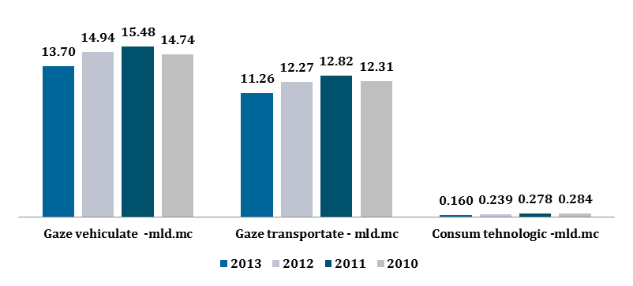
3. Main earnings’ drivers (5)
Circulated gas – bcm Transmitted gas – bcm Technological consumption - bcm
Revenue from domestic gas transmission
Revenue from international gas transmission
Other revenues

Slide 10
3. Main earnings’ drivers (6)
General considerations
Transgaz income is achieved through the following activities :
The natural gas transmission activity which, due to its character of monopoly, is regulated by the National Energy Regulatory Authority.
The revenue obtained from gas transmission activity is regulated by ANRE Order no. 22/2012 approving the Methodology for price fixing and regulated tariff setting in the natural gas sector, with subsequent amendments and completions.
The regulated total revenues of the gas transmission activity is determined in accordance with the above mentioned methodology and is the base for regulated tariff setting for the natural gas transmission, function of reserved capacities, and the gas volumes transported. The structure of regulated total income includes the following elements:
operational costs recognized by the authority (materials, energy and water, technological consumption, wages, maintenance and repair, and others);
regulated depreciation of gas transmission related assets;
pass-through costs, costs beyond the control of the operator ( royalty for NTS concession, gas transmission license fee, wage fund related contributions, other taxes and duties);
regulated profit determined by applying the regulated rate of return on capital employed to the value of the regulated assets used for gas transmission activity.
The settlement of the regulated revenues is made on regulatory periods of 5 years (the current period is 1 July 2012-30 June 2017), and within the regulatory period, annually, the regulated revenue is adjusted depending on the annual inflation rate decreased by an economic efficiency growth factor, the value of fixed assets put into operation (by afferent regulated depreciation and respectively the afferent regulated profit) and the achievement or failure to achieve the regulated income approved for the previous gas year, as follows:
if in the previous year was obtained a regulated revenue higher than the one approved the difference is subtracted from the regulated income of the next year;
if in the previous year was obtained a regulated revenue lower than the one approved the difference is added to the regulated income of the next year.
Following the regulation of the gas transmission activity according to the above mentioned methodology, the revenues obtained from the gas transmission activity cover the expenses generated by it and give the possibility of obtaining a regulated profit limited to 7.72% of the capital invested in this activity, i.e. 9.12% for the investments placed after July 1, 2012, according to ANRE Order no. 23/11.06.2012.
The activity of international gas transmission, which is also a gas transmission activity but - since it is conducted through dedicated gas transmission pipelines (pipelines which are not interconnected with the national gas transmission system) - is not a regulated activity, and the tarrifs are set on a commercial basis through negotiations between parties.
The total revenues of the company are also completed by the revenues from other activities with a low weight in the turnover, such as asset sales, rents, royalties, and by the financial revenues from interests and exchange rate differences.

Slide 11
Revenue cap methodology diagram (First year of regulatory period)
Regulated asset base
Regulated profit
+
Capacity reservation tariff
×
Estimated amount of reserved capacity
×
Depreciation for the regulated asset base
Regulated rate of return
+
Total revenues allowed
+
Operational expenses
Volumetric component of the gas transmission tariff
×
Estimated transported volumes
+
Royalty
Pass-through costs
+
Tax on wages and other taxes
Adjustments made in the following years (years 2 – 5 of the regulatory period)
Regulated revenues for the year t-1
Regulated total revenues for the year t
×
+
Capacity reservation tariff
Estimated amount of reserved capacity
Profit related to new investments
×
1 + Inflation– Efficiency factor
+
Depreciation of the new investments
Total revenues allowed
+
+
Volumetric component of the gas transmission tariff
×
Estimated transported volumes
Unrealized revenue
+
Pass-through costs

Slide 12
The major changes in methodology in the third regulatory period (1 July 2012 – 30 June 2017)
Adjustments in methodology…
…With positive impact
Reduced risk of unrealized revenue accumulation
The capacity component increases from 6% to approximately 35% of the total regulated revenue.
Management stimulated to achieve and maintain efficiency increases.
The increase in efficiency obtained in the current year – retained by the operator for five years.
Highly probable recovery in the current regulatory period of the revenues unrealized in the previous regulatory period.
The revenues unrealized in the second regulatory period are reduced by the increase in efficiency. These will be recovered in the third regulatory period.
New investments – higher profits, easier to finance
The rate of return for the third regulatory period decreased from 7.88% to 7.72%.
The rate of return for the new investments increased from 7.88% to 9.12%.

Slide 13
3. Main earnings’ drivers (7)
Complex evolutions in 2013 vs. 2012
Preliminary total revenues increased by 10% compared to 2012, by a total of 137,078 thousand RON.
The revenues were influenced mainly by the following factors:
capacity reservation tariff higher compared to 2012 with 0.812 RON/MWh, with a positive influence of 253,026 thousand RON;
volumes of gas transported lower with 10,725,281 MWh/1,014,634 thousand cm (8%), with a negative influence of 80,440 thousand RON;
volumetric component of the gas transmission tariff lower with 0.076 RON/MWh, with a negative influence of 9,159 thousand RON;
revenues from international gas transmission services lower compared to 2012 with 7,338 thousand RON, due to an average exchange rate RON/EURO, respectively RON/USD, lower than the one achieved in 2012;
financial revenues with a negative influence of 14,011 thousand RON due to the reduction of the company’s bank deposits.
The operating expenses are lower with 1% compared to 2012, respectively with 12,630 thousand RON.
Savings of 96,050 thousand RON were registered, mainly, due to the following expense items of expenses:
Savings with the consumption and technological losses of natural gas on the gas transmission system of 23,425 thousand RON, due to the following two factors:
natural gas amount for technological consumption lower compared to 2012 with 879,325 MWh/79,082 thousand cm (35%), a positive influence of 41,144 thousand RON;
average acquisition price estimated for 2013 higher compared to 2012 with 10,659 RON/MWh, with a negative influence of 17,719 thousand RON;
Savings with works and services carried out by third parties: 38,051 thousand RON;
Savings with other operating expenses: 32,876 thousand RON due to higher provision expenses in 2012.
Expense increases of 83,420 thousand RON as per:
tax on monopoly: 40,121 thousand RON;
depreciation of fixed assets: 16,354 thousand RON;
expenses with the personnel: 11,244 thousand RON;
Royalty for NTS concession: 15,103 thousand RON.
The financial expenses have registered an increase of 114,802 thousand RON due to the provision for financial assets depreciation (in value of 110,671 thousand RON) representing the Transgaz contribution to the share capital of Nabucco Gas Pipeline International GmbH, consequence of non-selection of Nabucco West Project as gas transmission route.
The preliminary total expenses increased with 10% compared to 2012, by 102,172 thousand RON.
Compared to 31 December 2012 the preliminary gross profit for 2013 is higher with 9%, respectively with 34,906 thousand RON.

Slide 14
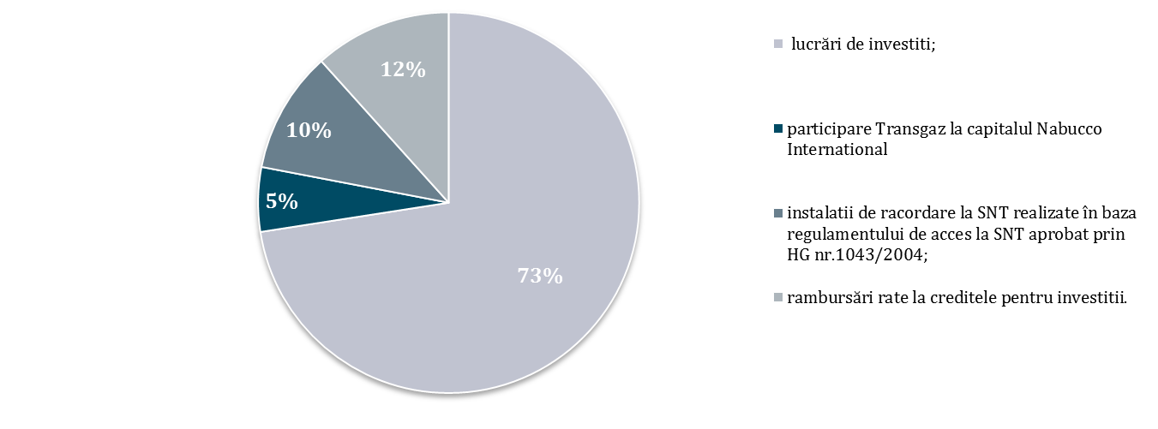
4. 2013 Investment costs
thousand RON
149,425 | Investment works; | 73%
11,268 | Transgaz’s contribution to Nabucco International capital | 5%
21,291 | NTS tie-in installations under the NTS access rules approved by Government Resolution 1043/2004; | 10%
24,000 | Investment loan installment payback | 12%
205,984 | Investment total costs | 100%
Investments amounting 204.831 thousand RON were made in 2013.
Investment works
Transgaz contribution to Nabucco International
capital
NTS tie-in installations under the NTS access rules approved by Government Resolution 1043/2004
Investment loan installment payback

Slide 15
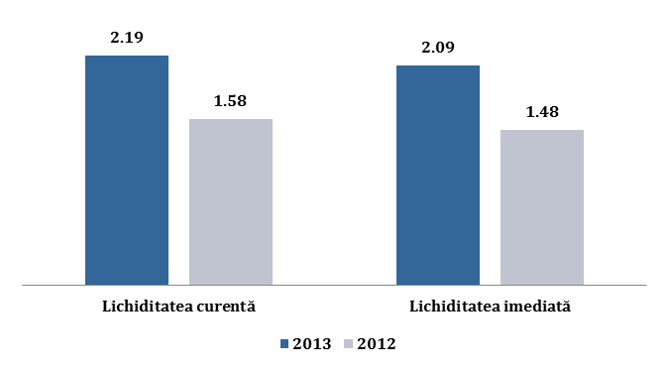
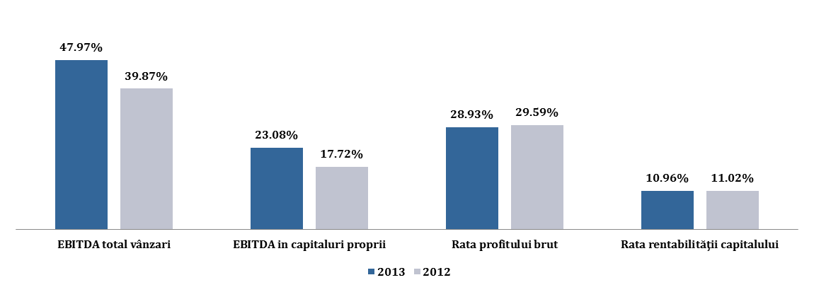
5. Economic and financial indicators as at 31.12.2013
 | 2013 | 2012
EBITDA/total sales | 47.97% | 39.87%
EBITDA/equity | 23.08% | 17.72%
Gross profit rate | 28.93% | 29.59%
Rate of return on capital | 10.96% | 11.02%
Current ratio | 2.19 | 1.58
Quick ratio | 2.09 | 1.48
Gearing | 0.78% | 1.61%
Interest coverage ratio | 185.51 | 93.90
Turnover speed for clients debit - days | 97.94 | 104,94
Current ratio Quick ratio
EBITDA/total sales EBITDA/equity Gross profit rate Rate of return on capital

Slide 16
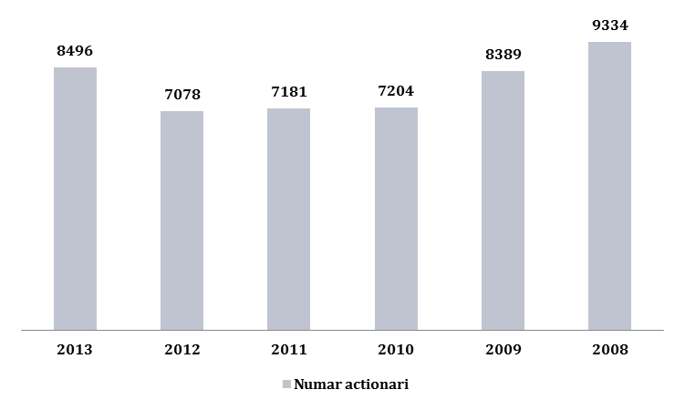
6. Shareholders
 | January 2008 | January 2013 | 25 April 2013 after the SPO | Dec. 2013 after FP sell-off TGN shares
MECMA/MFP/SGG | 75.0123% | 73.5097% | 58.5097% | 58.5097%
Fondul Proprietatea | 14.9876% | 14.9876% | 14.9876% | 0.0000%
Free float of which: | 9.9999% | 11.5025% | 26.5027% | 41.4903%
Natural persons | 6.2016% | 5.0799% | 6.9432% | 11.5706%
Legal persons | 3.7983% | 6.4226% | 19.5595% | 29.9197%
General Secretariat of the Government
Number of shareholders

Slide 17
7. Peer comparison (2013 y.e.)
Company |  | P/E | P/BV | EV/EBITDA
Enagas | Spain | 11.76 | 2.2 | 7.83
SNAM Rete Gas | Italy | 14.61 | 2.39 | 9.71
Fluxys | Belgium | 27.78 | 2.7 | 10.51
Media |  | 18.05 | 2.43 | 9.35
Transgaz | Romania | 6.87 | 0.75 | 4.33
Premium /Discount |  | -62% | -69% | -54%
Mkt. Cap CAGR 7.2%
Market capitalization RON
Market capitalization EUR

Slide 18
8.Management
ION STERIAN– Chairman of the Board of Administration
PETRU ION VĂDUVA – member of the Board of Administration – Director General
BOGDAN ILIESCU – member of the Board of Administration
REMUS VULPESCU – member of the Board of Administration
RADU CERNOV – member of the Board of Administration

