Slide 1

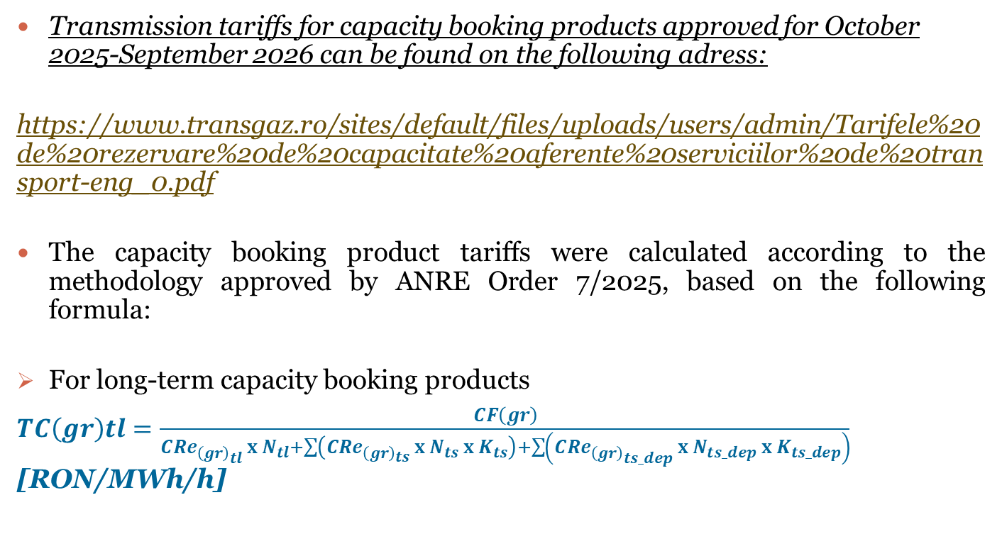
Information regarding the transmission tariffs approved by ANRE Order No.22/2025 for period oct.2025-sept.2026
Transmission tariffs for capacity booking products approved for October 2025-September 2026 can be found on the following adress:
https://www.transgaz.ro/sites/default/files/uploads/users/admin/Tarifele%20de%20rezervare%20de%20capacitate%20aferente%20serviciilor%20de%20transport-eng_0.pdf
The capacity booking product tariffs were calculated according to the methodology approved by ANRE Order 7/2025, based on the following formula:
For long-term capacity booking products
$TC\left(gr\right)tl=\frac{CF\left(gr\right)}{{CRe}_{{\left(gr\right)}_{tl} }x N_{tl}+\sum{\left({CRe}_{{\left(gr\right)}_{ts} }x N_{ts} x K_{ts}\right)+\sum{\left({CRe}_{{\left(gr\right)}_{ts_dep} }x N_{ts_dep} x K_{ts_dep}\right)}}}$ [RON/MWh/h]

Slide 2
Information regarding the transmission tariffs approved by ANRE Order No. 22/2025 for period oct.2025-sept.2026
where: TC(gr)tl – is the long-term firm capacity booking transmission tariff for the group of entry/exit points (gr);
CF(gr) – is the value of the fix component of the total revenue allocated to the group of entry/exit points (gr);
CRe(gr)_{tl}– is the capacity estimated to be booked over the long term in the period for which transmission tariffs are set, by the group of entry/exit points (gr);
CRe(gr)_{ts}– is the capacity estimated to be booked over the short term in the period for which transmission tariffs are set, by the group of entry/exit points (gr);
CRe(gr)_{ts dep}– is the capacity estimated to be booked over the short term in the period for which transmission tariffs are set, by the group of entry/exit points (gr) storrage facilities;
N_{tl,ts ts_dep} – number of hours for each type of service.
K(ts) – capacity booking tariff multiplication ratio for the type of short-term firm service.
K(ts) dep – capacity booking tariff multiplication ratio for the type of short-term firm service for storrrage facilities and represent 50% of K(ts).
For the short-term capacity booking products
TC(gr)ts=TC(gr)tl x K(ts/ts_dep) [lei/MWh/h]
where: TC(gr(ts)) – is the short-term firm capacity booking tariff for the group of entry/exit points (gr);
TC(gr(tl)) - is the long-term firm capacity booking tariff for the group of entry/exit points (gr);
K(ts) - capacity booking tariff multiplication ratio for the type of short-term firm service.
K(ts) dep – capacity booking tariff multiplication ratio for the type of short-term firm service for storrrage facilities and represent 50% of K(ts).

Slide 3
Information regarding the transmission tariffs approved by ANRE Order No. 22/2025 for period oct.2025-sept.2026
Commodity transmission tariffs approved by ANRE Order 22/2025, for October 2025-September 2026 is 1,80 RON/MWh transmitted
The commodity tariff for the quantity of gas transmitted (without the monopoly tax) was calculated according to the methodology approved based on the following formula:
CV(i)
TV(i) = --------------
Qtr(i)
where:
TV(i) – is the commodity tariff calculated for 1MWh transmitted in year (i);
CV(i) – is the commodity component of the total revenue in year (i);
Qtr(i) – is the gas quantity estimated by the licence holder to be transmitted in year (i), expressed in MWh.

