Slide 1

Information on the transmission tariffs approved by ANRE Order 99/2018 for the period October 2018-September 2019
Transmission tariffs for the capacity booking products, approved for the period October 2018-September 2019, expressed in RON/MWh/hour
Isaccea I – Negru Voda I pipeline entry/exit point/group of entry/exit points | Types of gas transmssion services RON/kWh/h(25°C/0°C)
 | Long term | Short term
 | Annual | Quarterly |  | Monthly |  | Daily
 |  | Summer | Winter | Summer | Winter | Summer | Winter
Isaccea 1 entry point | 0,0007991 | 0,000887 | 0,0011907 | 0,0010229 | 0,0013745 | 0,0020378 | 0,0027570
Group of Negru Voda 1 exit points and the exit points for gas supply to Romanian towns | 0,0007991 | 0,000887 | 0,0011907 | 0,0010229 | 0,0013745 | 0,0020378 | 0,0027570

Slide 2
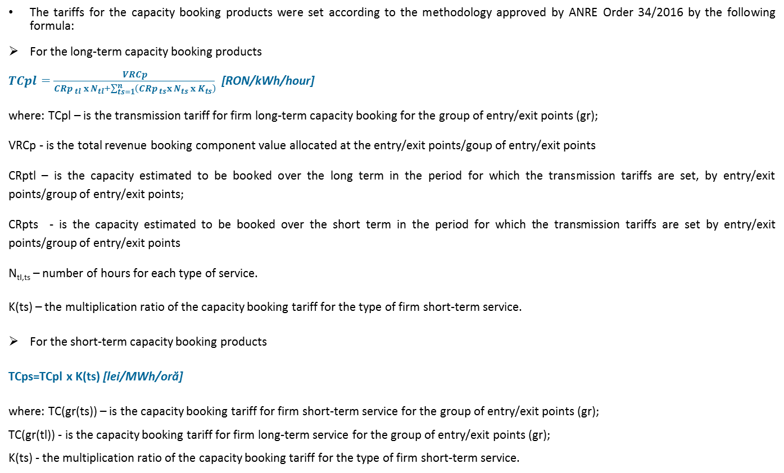
Information on the transmission tariffs approved by ANRE Order 99/2018 for the period October 2018-September 2019
The tariffs for the capacity booking products were set according to the methodology approved by ANRE Order 34/2016 by the following formula:
For the long-term capacity booking products
$TCpl=\frac{VRCp}{{{CRp}_{ tl}}_{ }x N_{tl}+\sum_{ts=1}^{n}{\left({CRp}_{ ts}x N_{ts} x K_{ts}\right)}}$ [RON/kWh/hour]
where: TCpl – is the transmission tariff for firm long-term capacity booking for the group of entry/exit points (gr);
VRCp - is the total revenue booking component value allocated at the entry/exit points/goup of entry/exit points
CRptl – is the capacity estimated to be booked over the long term in the period for which the transmission tariffs are set, by entry/exit points/group of entry/exit points;
CRpts - is the capacity estimated to be booked over the short term in the period for which the transmission tariffs are set by entry/exit points/group of entry/exit points
N_{tl,ts} – number of hours for each type of service.
K(ts) – the multiplication ratio of the capacity booking tariff for the type of firm short-term service.
For the short-term capacity booking products
TCps=TCpl x K(ts) [lei/MWh/oră]
where: TC(gr(ts)) – is the capacity booking tariff for firm short-term service for the group of entry/exit points (gr);
TC(gr(tl)) - is the capacity booking tariff for firm long-term service for the group of entry/exit points (gr);
K(ts) - the multiplication ratio of the capacity booking tariff for the type of firm short-term service.

