Slide 1

Information regarding the transmission tariffs approved by ANRE Order No.98/2018 for period oct.2018-sept.2019
Transmission tariffs for capacity booking products approved for October 2018-September 2019 in RON/MWh/h
Group of NTS entry/exit points |  | Types of gas transmission services
 |  | Long-term | Short-term
 |  | Yearly | Quarterly |  | Monthly |  | Daily
 |  |  | Summer | Winter | Summer | Winter | Summer | Winter
 | NTS group of entry points from production facilities, LNG terminals facilities for production of biogas or other gas compliant with the quality conditions enabling their delivery to/transmission through he gas transmission system, interconnection with other gas transmission systems and gas underground storages | 1,68 | 1,51 | 2,85 | 1,74 | 3,29 | 3,48 | 6,58
 | NTS group of exit points to direct consumers, distribution systems, underground gas storages, pipelines for upstream and other interconnected systems supply. | 1,63 | 1,47 | 2,78 | 1,70 | 3,20 | 3,39 | 6,41

Slide 2
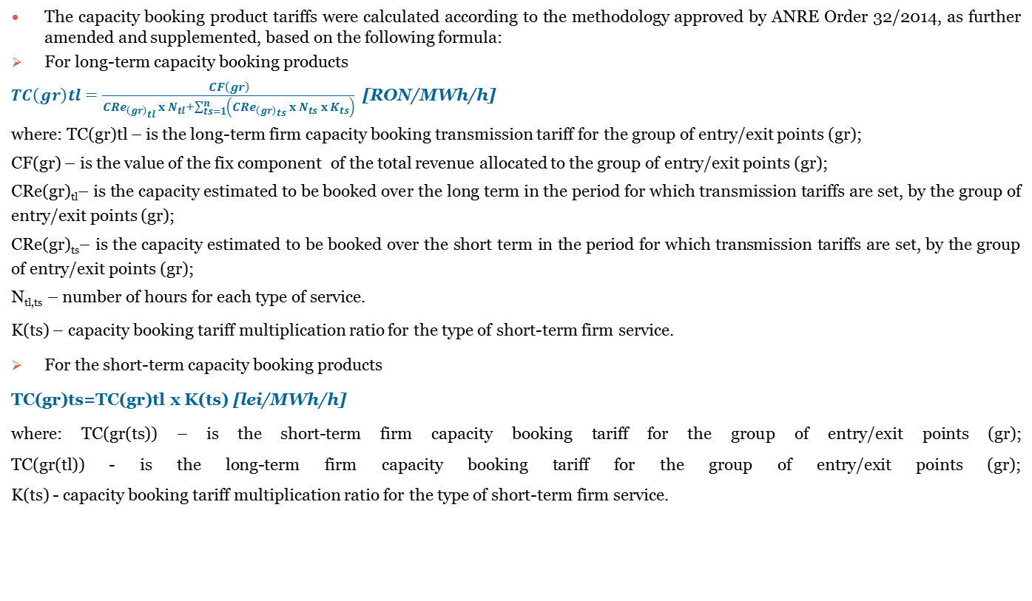
Information regarding the transmission tariffs approved by ANRE Order No.98/2018 for period oct.2018-sept.2019
The capacity booking product tariffs were calculated according to the methodology approved by ANRE Order 32/2014, as further amended and supplemented, based on the following formula:
For long-term capacity booking products
$TC\left(gr\right)tl=\frac{CF\left(gr\right)}{{CRe}_{{\left(gr\right)}_{tl} }x N_{tl}+\sum_{ts=1}^{n}{\left({CRe}_{{\left(gr\right)}_{ts} }x N_{ts} x K_{ts}\right)}}$ [RON/MWh/h]
where: TC(gr)tl – is the long-term firm capacity booking transmission tariff for the group of entry/exit points (gr);
CF(gr) – is the value of the fix component of the total revenue allocated to the group of entry/exit points (gr);
CRe(gr)_{tl}– is the capacity estimated to be booked over the long term in the period for which transmission tariffs are set, by the group of entry/exit points (gr);
CRe(gr)_{ts}– is the capacity estimated to be booked over the short term in the period for which transmission tariffs are set, by the group of entry/exit points (gr);
N_{tl,ts} – number of hours for each type of service.
K(ts) – capacity booking tariff multiplication ratio for the type of short-term firm service.
For the short-term capacity booking products
TC(gr)ts=TC(gr)tl x K(ts) [lei/MWh/h]
where: TC(gr(ts)) – is the short-term firm capacity booking tariff for the group of entry/exit points (gr);
TC(gr(tl)) - is the long-term firm capacity booking tariff for the group of entry/exit points (gr);
K(ts) - capacity booking tariff multiplication ratio for the type of short-term firm service.

Slide 3
Information regarding the transmission tariffs approved by ANRE Order No.98/2018 for period oct.2018-sept.2019
Commodity transmission tariffs approved by ANRE Order 98/2018, for October 2018-September 2019 (calculated by adding the tax on the monopoly, according to GO 5/2013, as further amended and supplemented)
The commodity tariff for the quantity of gas transmitted (without the monopoly tax) was calculated according to the methodology approved based on the following formula:
CV(i)
TV(i) = --------------
Qtr(i)
where:
TV(i) – is the commodity tariff calculated for 1MWh transmitted in year (i);
CV(i) – is the commodity component of the total revenue in year (i);
Qtr(i) – is the gas quantity estimated by the licence holder to be transmitted in year (i), expressed in MWh.
Commodity tariffs for gas transmission through the National Transmission System:
Commodity tariffs for the quantity of gas transmitted to the distribution systems | 1,97 RON/MWh transmitted
Commodity tariffs for the quantity of gas transmitted only through the National Transmission System | 2,72 RON/MWh transmitted

